Slide 1



YOUR TRUSTED TRAINING PARTNER
Visit Our Website
www.koenig-solutions.com

Slide 2





Why Choose
Koenig Solutions?
30+ Years in IT Training
Official Training Programs
300+ Full-Time Instructors
100,000+ Individuals Trained Every Year
Global Presence in over 12 Countries

Slide 3
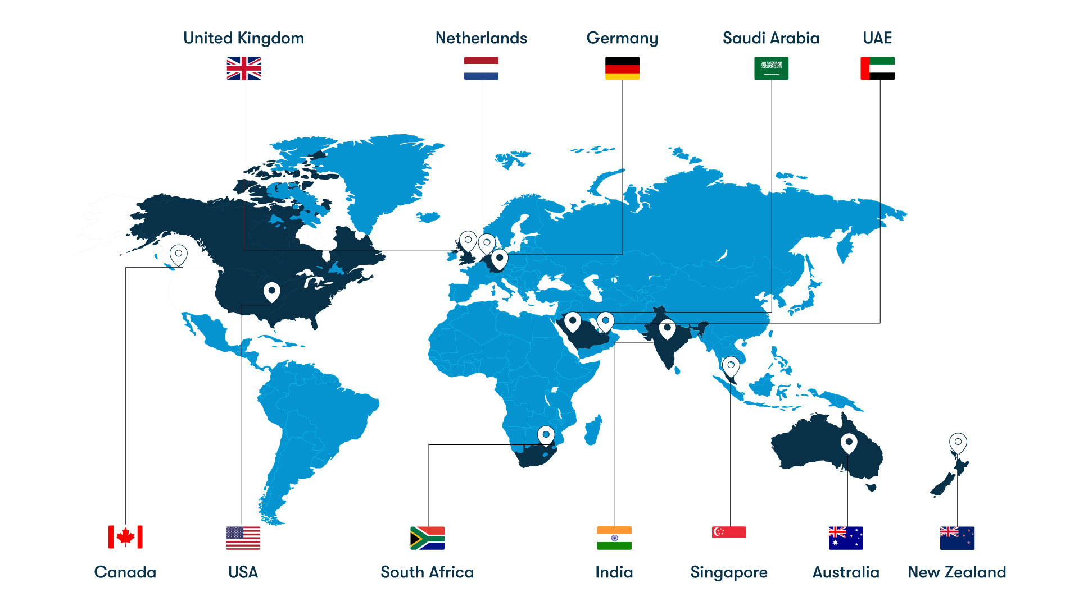
Koenig: Empowering You. Wherever You Are.

Slide 4





Koenig’s Range Of
Learning Options For You
Live Online Classes
Classroom Training
Fly-Me-A-Trainer (FMAT)
Flexi
Flexible virtual learning with expert instructors from the comfort of your own space.
Traditional, instructor-led training in popular global destinations.
Flexible on-site learning for larger groups. Fly an expert to your location, anywhere in the world.
Self-paced learning with editable lectures, courseware, hands-on labs and optional doubt clearing sessions.

Slide 5





Koenig’s Unique Offerings
Experience the Koenig difference: Craft your training journey with personalized learning, flexible options, and expert support.
1-on-1 Training
Flexible Dates
A 1-on-1 personalised training session with ​expert instructors.
To help customers schedule their classes as per their convenience.
4-Hour Sessions
Revision Classes
Flexible sessions for busy professionals. Maximize knowledge retention, minimize fatigue.
To help customers get a firm grasp on the subject and excel.

Slide 6




Koenig’s Unique Offerings - Contd.
Master in-demand skills with confidence. Koenig Solutions fosters active learning through resources, assessments, and opportunities for revision to solidify your knowledge.
Lab Extensions
Assessments
Access to our world-class labs to gain practical knowledge.
Access to Qubits - a self-assessment platform to evaluate your learnings and progress.
Class Recordings
5000+ Courses
Access to all class recordings for future reference and review.
Explore a range of courses which are not offered by popular vendors.

Slide 7
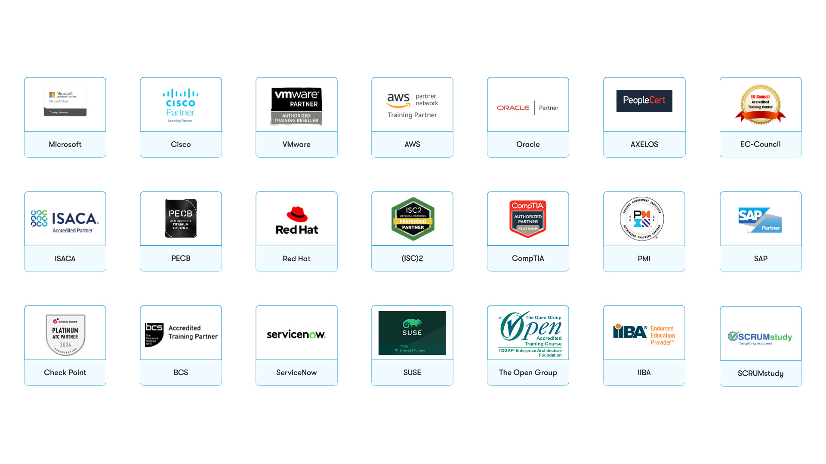
Koenig’s Valued Partners: Official Training
Learn More >>

Slide 8
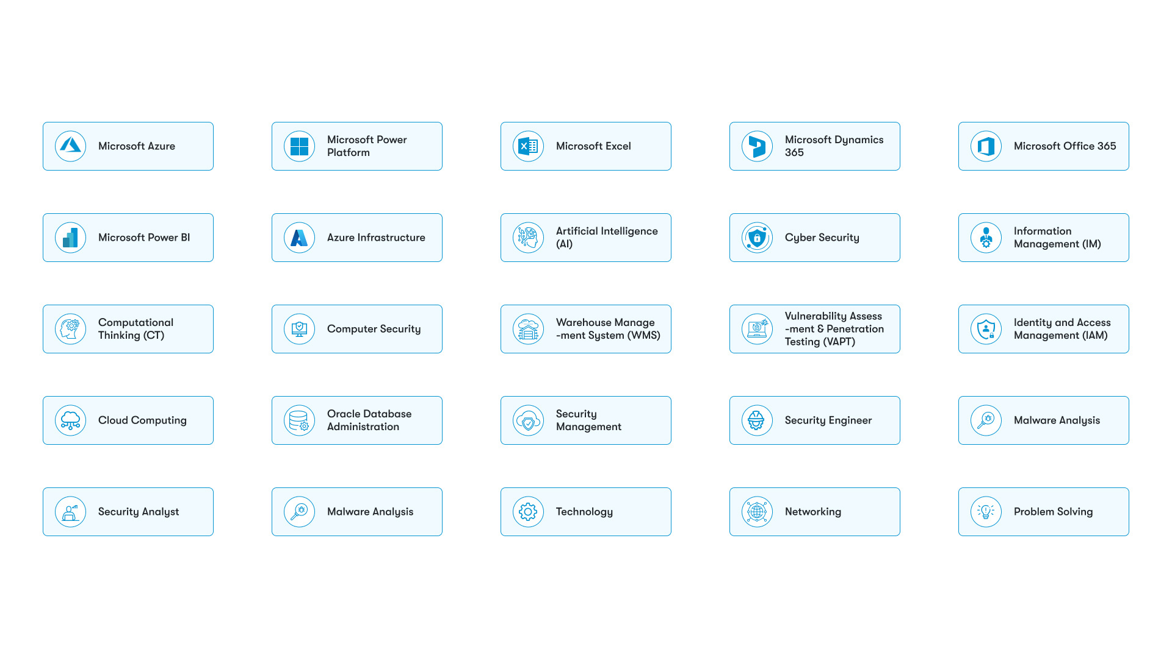
Our Range of In-Demand Technologies
And Many More!

Slide 9
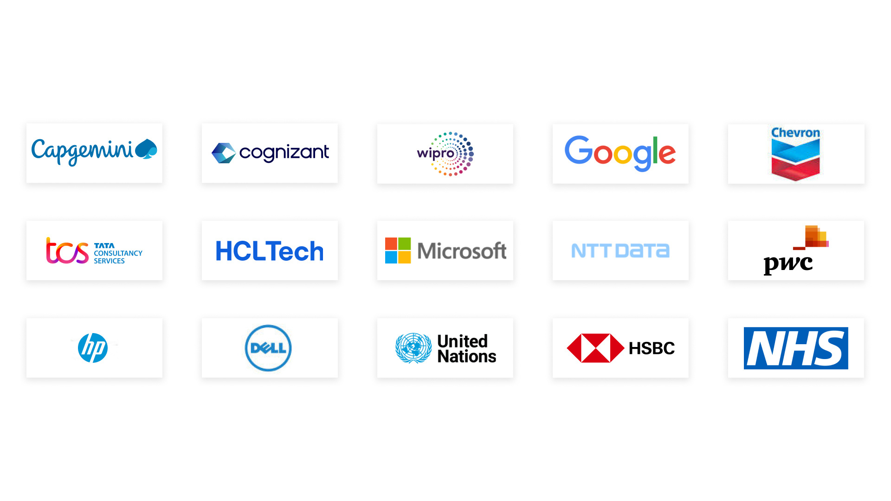
Our Valued Clientele

Slide 10
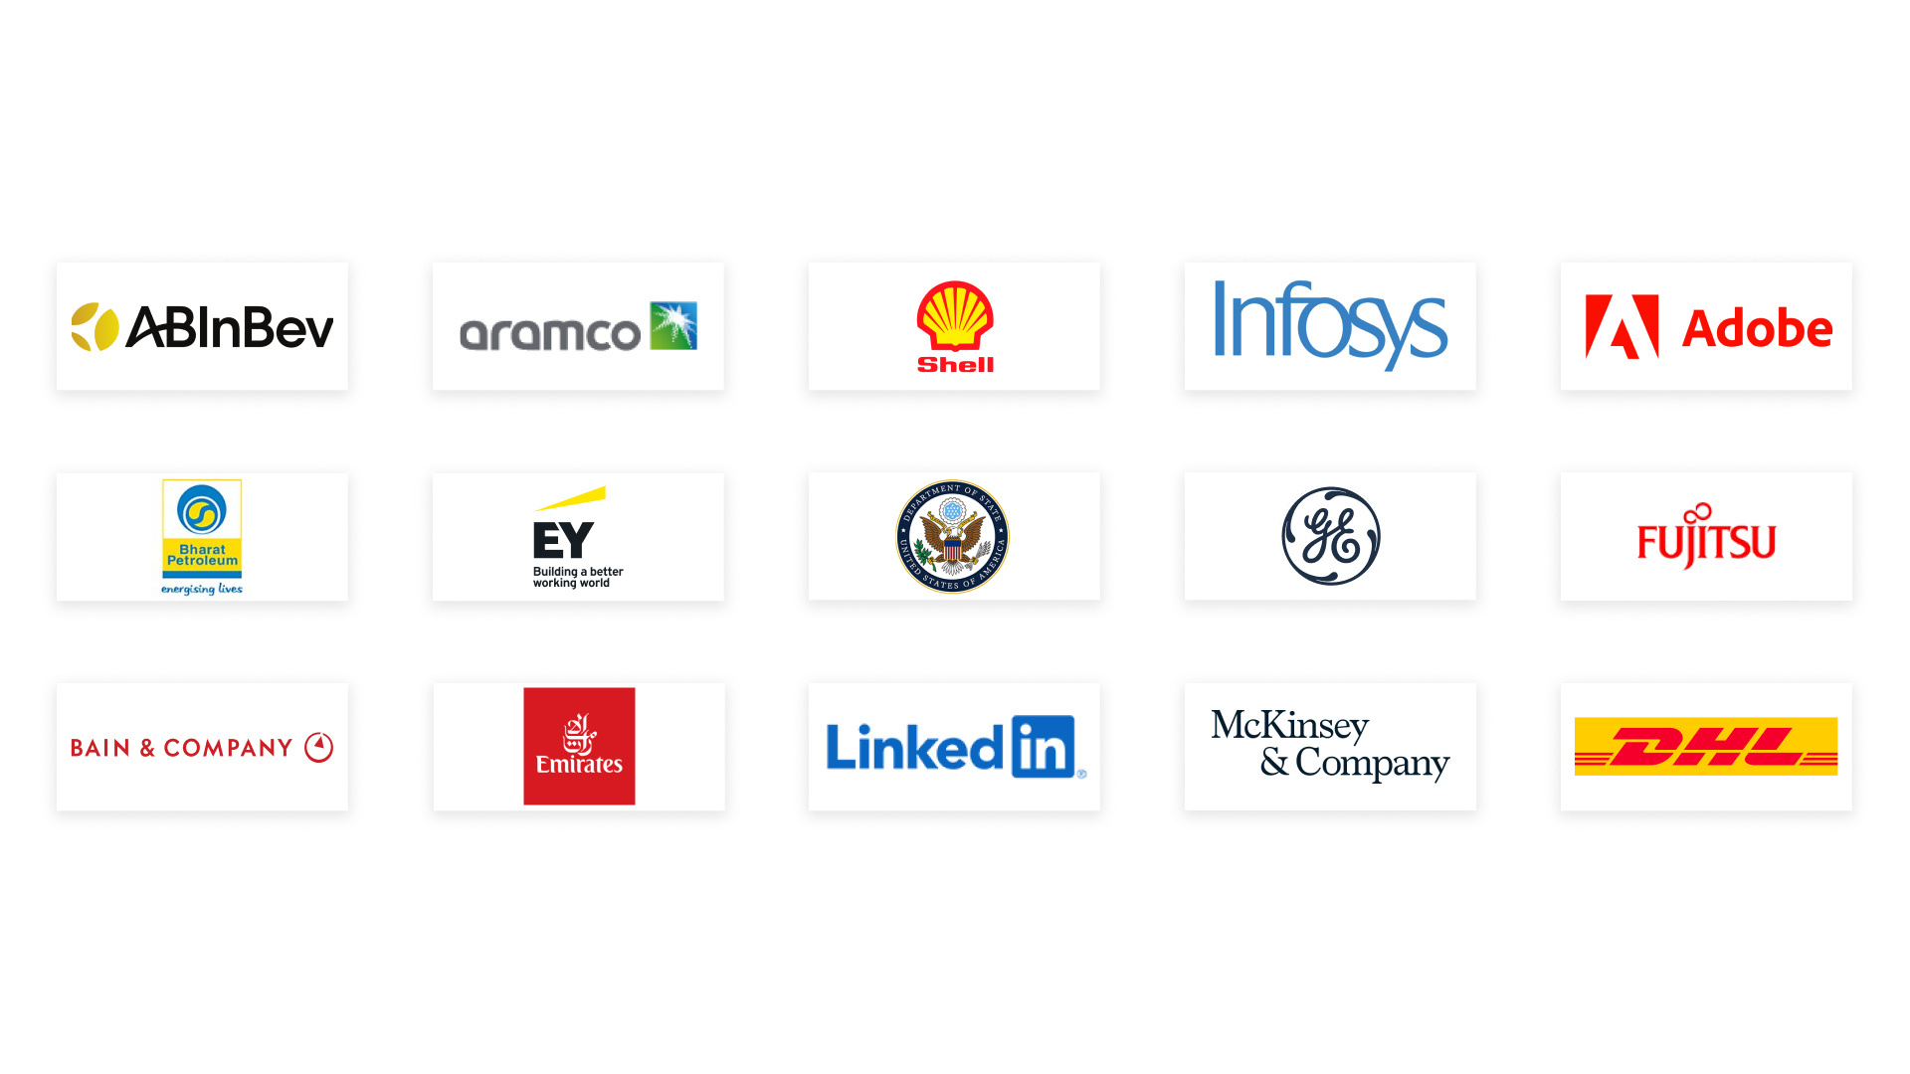
Our Valued Clientele - Contd.

Slide 11




Koenig’s Sustainable Business Practices
Employee Exchange for Digital Skills (EEDS)
Koenig’s initiative which helps bridge the gap between talent & employers in India.
Conserving Environment
As part of our sustainability efforts, we plant a tree for every business flight (Kustomer/Kites).
Permanent Work From Home
Permanent work-from-home fosters a healthy work-life balance for employees and reduces our environmental impact.
Best Place to Work (2010 - 2024)
Empowering and retaining top trainers since 2010, fostering a thriving workplace that minimizes resource impact.

Slide 12

Thank You
Visit Our Website
www.koenig-solutions.com

